Slide 1
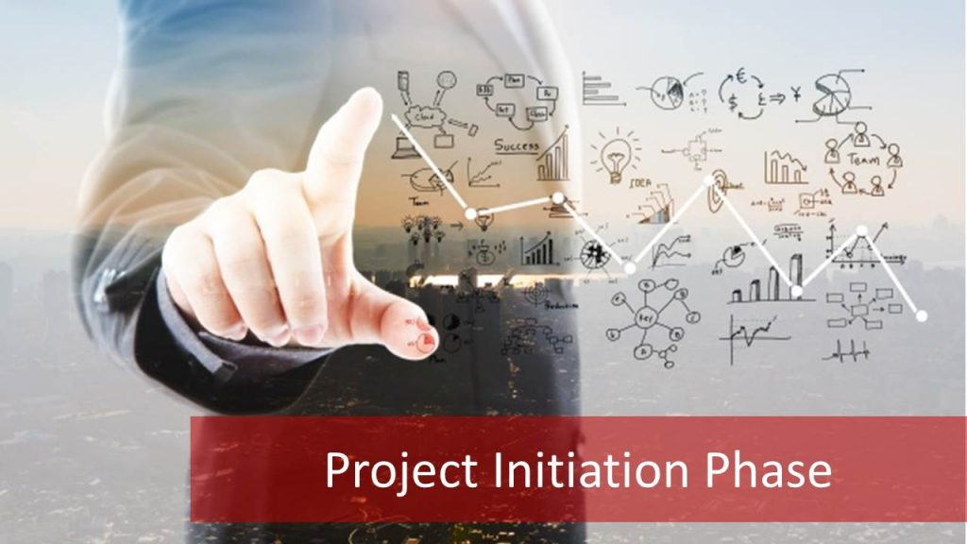
Module 5-6: PROJECT INITIATION

Slide 2
OBJECTIVES
Understand what project initiation is and its importance in the project lifecycle
Learn how to make a business case, and project charter as documents of project initiation
Know the six steps for a successful project initiation

Slide 3
What is project initiation
Project initiation is the first phase of the project management life cycle and in this stage, companies decide if the project is needed and how beneficial it will be for them.

Slide 4
Why is project initiation important
Taking major decisions that establish the direction and resource requirements, like the project charter and selecting the stakeholders, are made during this phase.
The stakeholders arrive at a clear objective to ensure everyone stays on the same page in terms of how the project should proceed.

Slide 5
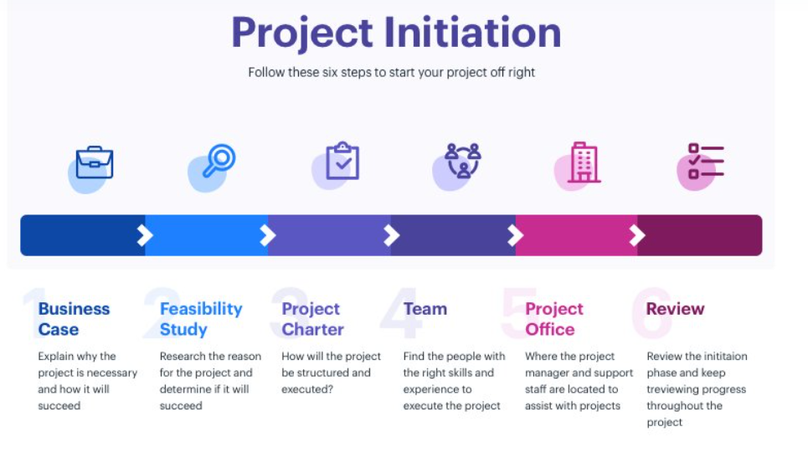
Project initiation phase: 6 steps to follow

Slide 6
The 6 steps in project initiation

Slide 7
Step 1: Create a business case
A business case is developed during the early stages of a project and outlines the why, what, how, and who necessary to decide if it is worthwhile continuing a project.
The business case, which is first developed during the project initiation phase, should be reviewed by the project sponsor and key stakeholders before being accepted, rejected, canceled, deferred, or revised.

Slide 8
COMPONENTS OF A BUSINESS CASE
Business problem or opportunity
Benefits
Risk
Costs including investment appraisal
Technical solutions
Timescale
Impact on operations
Organizational capability to deliver the project outcomes

Slide 9
Example of business case: A WEB PORTAL AND BUSINESS INTELLIGENCE PROJECT
COMPONENTS | EXAMPLE
Business Problem | It takes at least 2 months for the manual system to generate the reports.
Benefits of the new system | Reports can be generated in two weeks Submission of data will be in a web portal 20 operational and 50 analytical reports will be produced by the system The system will be hosted in a cloud using MS Azure
Risks | The project has high dependency on internet connections. Fluctuating internet will affect the users of the system and it will lead to dissatisfied users.
Cost of the project | This is estimated to cost Php50 million pesos.
Technical Solutions | Use of a web portal for submission of raw data Use of business intelligence software to generate the reports
Timescale | The project will take one year to implement
Impact on Operations | New job roles will be created to take on new and additional tasks
Organizational Capability | The existing IT department is not enough to sustain the project. There is a need for additional personnel to strengthen up IT.

Slide 10
Is the project worth doing?
What is your goal?
What’s stopping you from reaching the goal?
How much change is needed to overcome the problem?
Are you certain this will solve the problem?

Slide 11
WHEN TO USE A BUSINESS CASE
The business case is needed when resources or expenditure on a project has to be justified. Approval is usually sought from the project sponsor and other interested parties.
For instance, the finance function may authorize funds and the IT department provide resources.

Slide 12
Step 2: CONDUCTING a feasibility study

Slide 13
7 STEPS FOR A FEASIBILITY STUDY
Conduct a preliminary analysis
Prepare a Projected Income Statement
Conduct a Market Survey, or Perform Market Research
Plan Business Organization and Operations
Prepare an Opening Day Balance Sheet
Review and Analyze All Data
Make a Go/No-Go Decision

Slide 14
Step 3: establish a project charter

Slide 15
WHAT IS A PROJECT CHARTER
A project charter is a formal project authorization which documents the shared understanding of a project’s scope, development, and objectives, while also defining the roles and responsibilities of each party involved.

Slide 16
Importance of a project charter
The project charter is perhaps the most comprehensive and important part of the project initiation process. It answers the 3 Ws (when, where, why) to identify the scope/objective, team members, and the possible timeframe of the project.
The charter is, in some ways, the first document of the project that identifies the necessary details like the goals and the constraints of the project.
It also identifies the project scope and lists the required resources for the completion of the project.

Slide 17
DIFFENCE BETWEEN A PROJECT CHARTER VS. A PROJECT PLAN
A project charter should only include three elements: your project objectives, scope, and responsibilities. Once your charter has been approved, the project plan is created. The project plan builds on the project charter to provide a more in-depth blueprint of the key elements of the project.

Slide 18
PROJECT CHARTER TEMPLATE
PART | CONTENTS
Project Name | Name your project. Make sure this is descriptive enough that most people will understand what you’re working on.
Project Manager | Who is the point of contact for this project?
Last Revision Date | The project charter is a living document. Including the last revision date can be helpful for team members who are frequently checking back on the charter.
Project Purpose | Why are you working on this project?
Project Objectives | What deliverables and assets do you plan to achieve by the end of the project?
Project Scope | What are the boundaries of your project deliverables? Which initiatives are not included in the project?
Project Team and Resources | Who is working on this project? Which resources (e.g. people, tools, and budget) are available for this work.
Stakeholders and approvers | Who are the project stakeholders? Who needs to approve the project charter or any project deliverables?

Slide 19
EXAMPLE OF A PROJECT CHARTER
PART | CONTENTS
Project Name | Web Portal and Business Intelligence Project
Project Manager | Dittas A. Formoso
Last Revision Date | June 1, 2021
Project Purpose | The purpose of this project is to be able to automate the production of the different reports required by the agency to better assess the performance of the EC’s.
Project Objectives | The objectives of this project is to generate 20 operational reports and 50 analytical reports within two weeks from submission of data in the web portal.
Project Scope | The system starts when raw data is submitted by the EC’s in the web portal and ends with the generation of the operational and analytical reports. This will not include the metering system used by the ECs.
Project Team and Resources | There will be a team of 15 people (5 analysts and 10 developers) who will work full time in this project for one year at a cost of Php50 million.
Stakeholders and approvers | The system will be signed off by the agency administrator and CIO.

Slide 20
BENEFITS OF PROJECT CHARTER TO PROJECT MANAGERS AND TEAM
Helps determine project value: help you determine if it’s worthwhile to carry out or propose the project.
Saves time down the road: the time you take at the beginning is time you won’t need to spend troubleshooting and negotiating if you’ve already addressed these areas in the project charter.
Gives you budget clarity: ensure that funding is available and will be released on time. Settle your spending authority and budgets prior to starting the project.
Helps you give clear guidelines to your team: The milestones and criteria for measurement give invaluable guidance to your team as you begin to brief out the project.
Inspires confidence: gives the team assurance that they’re working under an effective and well-organized project manager.
Boosts team morale: A well-written charter gives clear guidelines for success that your team can feel motivated and confident to work toward.

Slide 21
Step 4: Identifying stakeholders and making a stakeholder register

Slide 22
What is the goal?
It’s the responsibility of the project manager to ensure the means and frequency of the communication with each stakeholder according to their influence and interest in the project.
A common practice is to maintain a stakeholder register or a stakeholder map to decide the frequency and means of communication for each stakeholder according to their influence and interest in the project.

Slide 23
STAKEHOLDER COMMUNICATIONS REGISTER
NAME | POSITION | MEANS OF COMMUNICATION | FREQUENCY
Rod Salazar | CIO | Face to Face Meeting | Once a week
Shirley Santos | Department Manager | E-mail | When necessary
Project team | Project team members | Face to Face Meeting | Once a week
Jun Padua | CFO | Face to face meeting | Once a month

Slide 24
STEP 5: Assembling the team and establishing a project office

Slide 25
What is the goal?
Assembling a working project team and assigning them roles and responsibilities is a vital part of the project initiation phase. Assigning roles and responsibilities early on also increases the overall accountability of the entire team and can help you as a manager in the later phases of the project life cycle.

Slide 26
Step 6: FINAL REVIEW
After performing everything, it’s a good practice to review the entire project initiation stage to ensure you missed nothing. In later stages, you’ll continue reviewing your work as monitoring and controlling is one of the five phases of the project management life cycle.

Slide 27
GROUP WORK
Write the business case for your project (in PPT)
Write the project charter of your project (in PPT)

